Slide 1

SEO Audit Report for Suvani Creations
Comprehensive Analysis & Recommendations for Improved Search Visibility
Conducted by: [Sneha]

Slide 2
SEO Audit Overview & Findings
This report presents the findings of an SEO audit conducted using various industry-leading tools, highlighting identified issues and providing a strategic action plan for optimization.
SEO Health Overview
Domain Age, DA, and Moz Rank
Website Page Speed
Open Graph & Canonical Tags
Sitemap & Robots.txt
Broken Links & URL Redirection
Mobile-Friendly & Mobile Rendering Test
User-Friendly URLs & Meta Tags (Title, Description)
Heading Tags & Alt Tags
Schema Implementation
SWOT Analysis

Slide 3
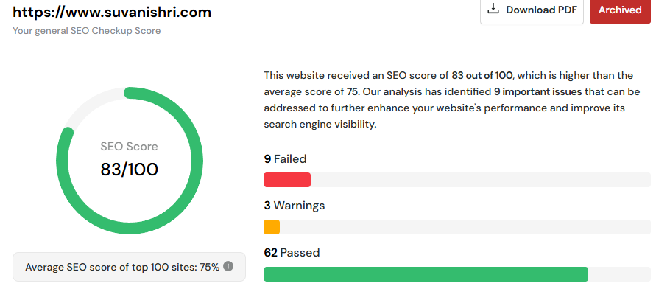
SEO Health Overview - Suvani creations
Meta Tags & Descriptions Optimization
Ensure unique meta titles & descriptions for each page.
Use targeted keywords to improve search visibility.
Keep descriptions between 150-170 characters with clear CTAs.
Meta Tags & Descriptions Optimization
Ensure unique meta titles & descriptions for each page.
Use targeted keywords to improve search visibility.
Meta Tags & Descriptions OptimizationKeep descriptions between 150-170 characters with clear CTAs.
SEO Score: 83/100 – A strong performance, but optimization opportunities remain. Enhance keyword targeting, and implement meta titles and descriptions to improve search visibility and rankings.
Ensure adding unique meta titles & descriptions for each page.
Use targeted keywords to improve search visibility.
Keep descriptions between 150-170 characters with clear CTAs.
Integrate Google Analytics and Search Console to monitor and enhance website performance effectively.

Slide 4
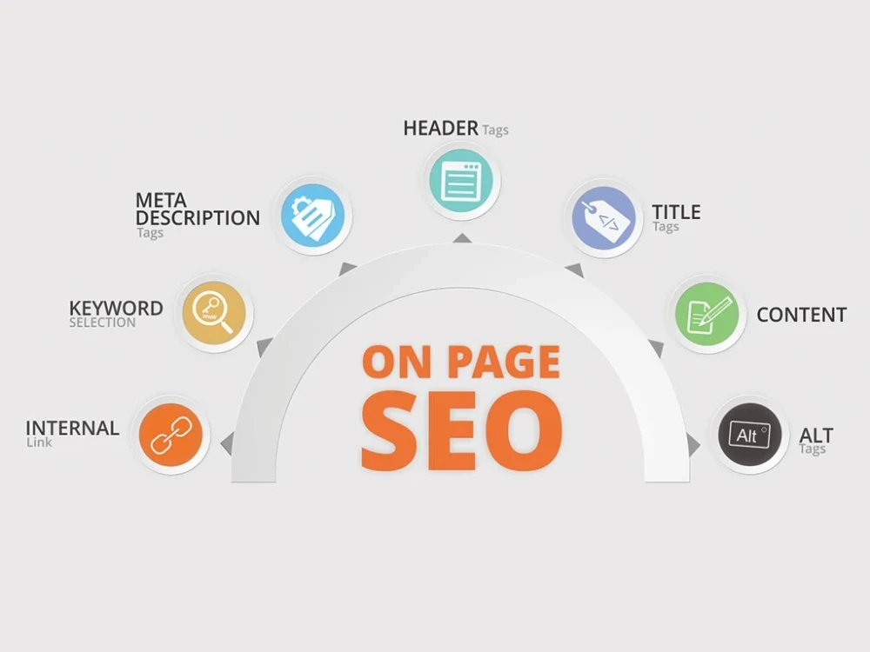
On-Page Analysis

Slide 5
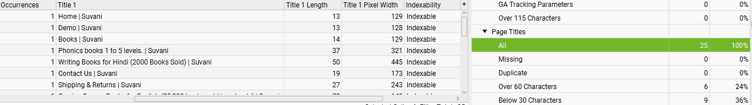
Meta Title
Current Issues Identified:
Title Length Issues: Several page titles are too short (below 30 characters), which may reduce their effectiveness in search rankings.
Keyword Optimization: Titles are not fully optimized with relevant keywords, missing opportunities for better visibility.
Short titles may not be compelling enough to encourage clicks in search results.
Recommended Action Plan:
Ensure all titles are between 50-70 characters to enhance visibility and CTR.
Include Primary Keywords: Each title should contain targeted, high-search-volume keywords relevant to the page content.
Ensure Uniqueness: Even though there are no duplicate titles, each title should be distinct and highly relevant to the specific page.

Slide 6
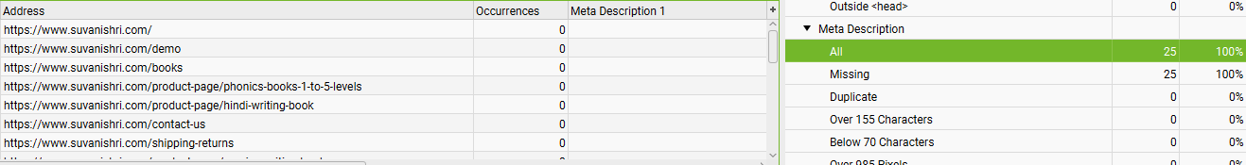
Meta Description
Current Issues Identified:
Missing Meta Descriptions – All 25 pages are missing meta descriptions. No Keywords in Meta Descriptions – Without optimized meta descriptions, search results may not be compelling enough to attract clicks. Potential Ranking Loss – Google may generate automatic meta descriptions, which may not align with target keywords.
Recommendations for Optimization:
Add Unique Meta Descriptions – Ensure each page has a compelling description within 150-170 characters. Use Primary Keywords – Incorporate targeted keywords relevant to the page’s content to improve ranking. Include Call-to-Action (CTA) – Encourage users to click with phrases like “Shop Now,” “Learn More,” or “Explore Collections.” Highlight Unique Selling Points (USP) – Mention what makes the page/product stand out, e.g., “Premium Handmade Books,” “Fast Shipping,” etc.

Slide 7
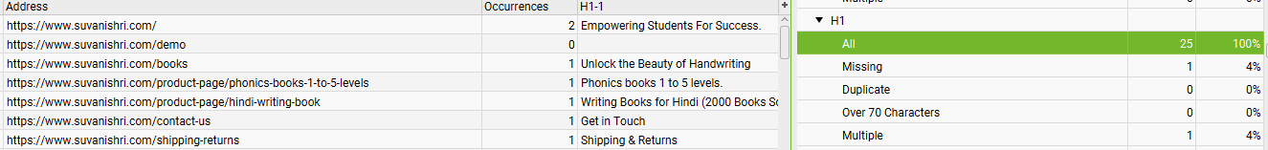
Heading Tags
Current Issues Identified:
Keywords in H1 tags are rarely used in the body text due to inadequate keyword research and optimization
One Page Missing an H1 Tag – Every page should have a properly optimized H1.
Recommendations for Improvement:
The H1 heading should clearly reflect the page topic and include relevant keywords.
Include the primary keyword naturally within the H1.
Keep it concise (50-70 characters) and engaging for both users & search engines.
Avoid multiple H1s to maintain clarity for search engines.Add only one H1 Tags,

Slide 8
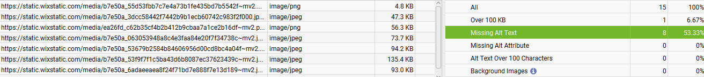
Alt Image Tags
Current Issues Identified:
Large Image Sizes: 1 image exceeds 100 KB, impacting page load speed.
Missing Alt Text: 8 images lack alt tags, reducing accessibility and SEO effectiveness.
Lack of Keyword Optimization: Image file names do not include relevant keywords, affecting search visibility.
Recommendations for Optimization:
Add Alt Text: Ensure every image includes descriptive alt text with primary and secondary keywords.
Optimize Image File Names: Rename images with relevant keywords
Compress Images: Reduce image sizes to below 100 KB to improve page speed, include keyword in the image URLs

Slide 9
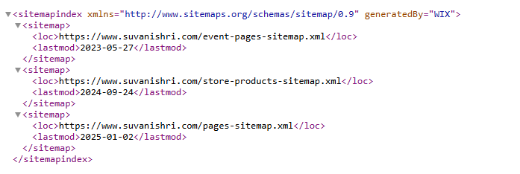
Sitemap.XML
Current Issues Identified:
XML Sitemap Detected: The website has an XML sitemap, which helps search engines crawl and index pages efficiently.
Outdated Event Pages Sitemap: The last update was in May 2023, meaning new event pages may not be indexed.
Recommendations for Optimization
Keep the XML Sitemap Updated: Ensure all new pages and updates are reflected in the sitemap, especially for event pages.

Slide 10
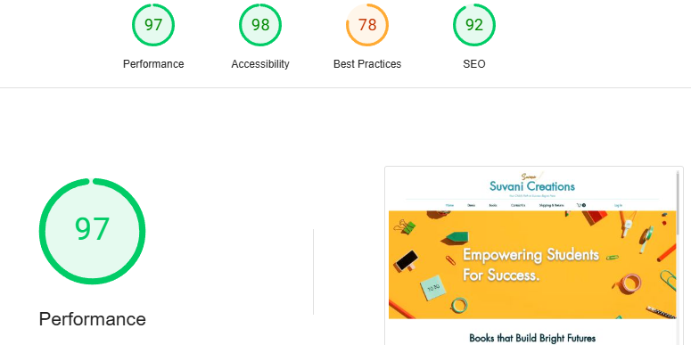
Website Page Speed - Desktop
Page load speed is the time it takes for a webpage to fully load in a user's browser. It’s influenced by several factors such as network performance, web server efficiency, page size, the technologies used, database issues, and potential coding errors. Addressing these issues may require the expertise of a developer or systems administrator. Load speed plays a crucial role in user experience and can directly affect bounce rates and conversion rates. Moreover, search engines now consider page load speed as an important ranking factor.
At Present:
Desktop loading time is strong with a score of 97/100.
Recommendations for Optimization:
Here are some guidelines to speed up your website,
Optimizing the size of the image by 100kb.
Minimizing the number of JavaScript and CSS files.
Adding the redirects using htaccess instead
Click the URL to learn more: https://pagespeed.web.dev/analysis/https-www-suvanishri-com/kdxaoevtiq?form_factor=desktop

Slide 11
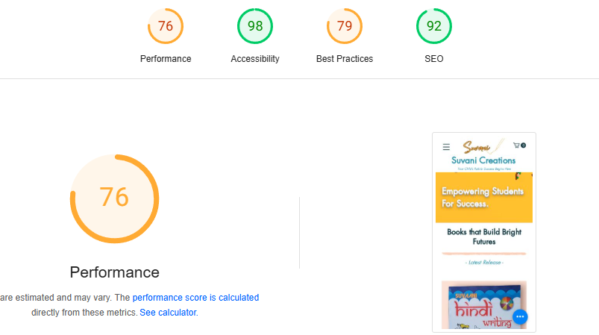
Website Page Speed - Mobile
Page load speed is the time it takes for a webpage to fully load in a user's browser. It’s influenced by several factors such as network performance, web server efficiency, page size, the technologies used, database issues, and potential coding errors. Addressing these issues may require the expertise of a developer or systems administrator. Load speed plays a crucial role in user experience and can directly affect bounce rates and conversion rates. Moreover, search engines now consider page load speed as an important ranking factor.
At Present:
Mobile loading time is decent with a score of 76/100
Recommendations for Optimization:
Optimizing the size of the image by 100kb.
Minimizing the number of JavaScript and CSS files.
Adding the redirects using htaccess instead
Optimize Fonts
Click the URL to learn more: https://pagespeed.web.dev/analysis/https-www-suvanishri-com/kdxaoevtiq?form_factor=mobile

Slide 12
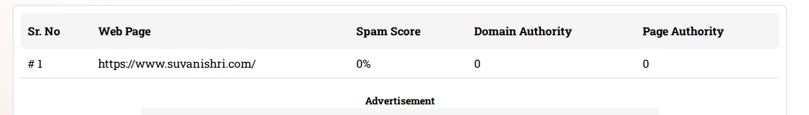
Spam Score & Domain Authority Checker
At Present:
Spam Score: 0% (Indicates no spam signals detected)
Domain Authority (DA): 0 (Very low authority, needs improvement)
Page Authority (PA): 0 (Indicates weak individual page strength)
Recommendations for Optimization:
Build High-Quality Backlinks
Improve Content Quality
Optimize On-Page SEO
Use proper H1, H2, meta tags, and internal linking.

Slide 13
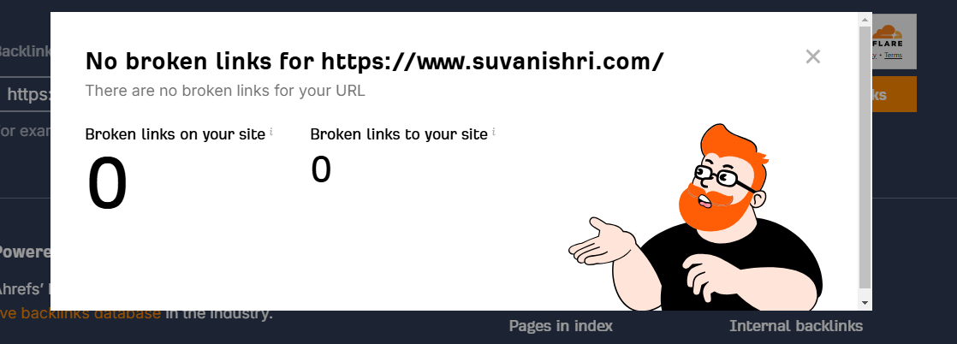
Broken Link
At Present:
This is a good sign! It indicates that:
All internal and external links on your site are functioning correctly.
There are no broken backlinks from other sites pointing to yours.
Recommendations for Optimization:
Even though there are no broken links now, regular monitoring is essential.

Slide 14

Google Tag Manager (GTM)
Google Tag Manager (GTM) is a free tag management system from Google that allows you to easily add, update, and manage tracking codes (tags) on your website or mobile app without modifying the site’s code.
Instead of manually adding tracking scripts (such as Google Analytics, Facebook Pixel, or Google Ads) to your website’s code, GTM helps you manage them all in one place through an easy-to-use interface.
At Present:
Your website does not have Google Tag Manager (GTM)
Recommendations for Optimization:
Install Google Tag Manager (GTM)

Slide 15
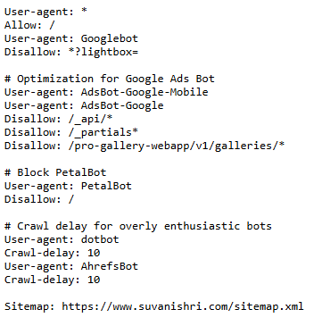
Robots.txt
Robots.txt files are text documents that provide instructions to web crawlers. They are the first resource a bot accesses when visiting a website. The rules within this file can apply to all bots or be targeted at specific ones.
At Present:
Current website has proper robots.txt file.
Recommendations for Optimization:
Review all URLs: Before launching the new website, compile a comprehensive list of pages or files that should be excluded from crawling and include them in the robots.txt file.
Test Your robots.txt: After making changes, use tools like Google Search Console’s robots.txt Tester to ensure the directives are working correctly.
This way, your robots.txt file will help optimize crawl efficiency and prevent unnecessary indexing of sensitive or non-essential content.

Slide 16

Mobile Friendly Test
A mobile-friendly test evaluates how well a website performs and displays on mobile devices, ensuring optimal user experience across various screen sizes. It checks for responsiveness, ease of navigation, and page load speed on smartphones and tablets.
At Present:
Your website is easy to use on a mobile device
Recommendations for Optimization:
None

Slide 17
User-Friendly URLs
Current Situation
All URLs on the website are clean and clear, with no underscores present.
No underscore URLs found.
Recommendations:
Ensure that URLs are descriptive and include relevant keywords to improve visibility in search engines.
Avoid unnecessary parameters
Focus on using keywords in URLs to enhance discoverability, attract targeted traffic, and boost conversions.

Slide 18
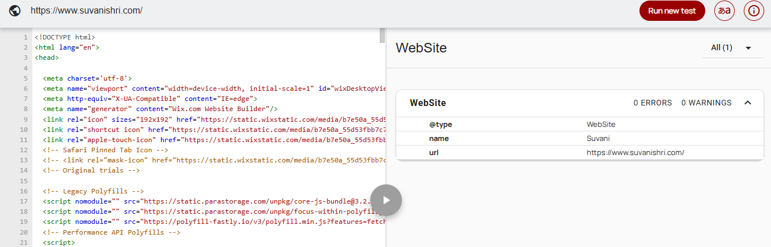
Schema Markup
Current situation: Website have proper schema on the website.
Recommendations:
Implement schema markup for services, reviews, and FAQs to improve visibility in search results.

Slide 19
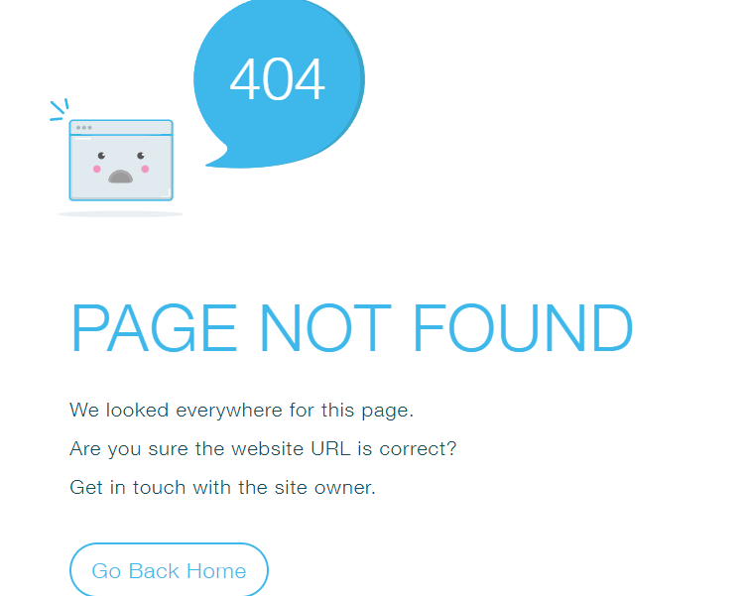
404 Page
Current Situation: The website currently has a 404 error page, but it is not properly optimized or user-friendly.
Recommendations: Enhance the 404 page by implementing a redirection strategy. Redirect users to relevant, high-traffic pages or the homepage to improve user experience and reduce bounce rates. Additionally, ensure the 404 page provides helpful navigation options, such as links to popular sections or a search function, to guide users effectively.

Slide 20
Canonical Tag
Current situation: Website having proper canonical page
Recommendations:
None

Slide 21
SWOT Analysis
Strengths:
Speed of the website is good on Desktop
URLs are User-Friendly
Clear Mission and Niche
High-Quality Educational Products:
Online Consultation
Provided
Weakness
Limited Online Engagement:
Product Variety
Shortage of keyword optimization
No Meta Tags and keyword optimization
Proper On -Page SEO not Implemented
Opportunities:
Expansion of Digital Content:
SEO Optimization: The website can improve search engine visibility by adding more keyword-rich content and optimizing product pages.
Threats:
Competitive Market: The educational material market is competitive, with numerous players offering similar products.
Seasonal Demand: Sales may fluctuate based on academic calendars and exam cycles.

Slide 22
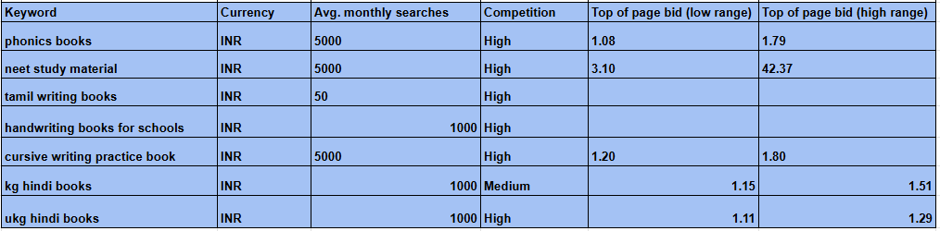
Keywords

Slide 23
SEO Recommendations - I
Keyword Optimization: Conduct thorough keyword research and incorporate relevant keywords throughout the content, titles, meta descriptions, headers, and alt text.
Title Tags: Optimize title tags for each page to include primary keywords and ensure they are unique and compelling.
Meta Descriptions: Update meta descriptions to include target keywords and create persuasive copy that encourages clicks.
Header Tags (H1, H2, etc.): Use header tags to structure content, with relevant keywords in H1s and H2s to improve content hierarchy.
Image Optimization: Ensure all images have descriptive, keyword-rich alt text, and compress image files for faster loading.
Page Load Speed: Improve page load times by optimizing images, using a Content Delivery Network (CDN), and leveraging browser caching.
Mobile Optimization: Ensure the website is fully responsive and provides a seamless user experience on mobile devices.
Internal Linking: Use internal links to guide users through the website and to help search engines understand the structure of the site.
Mobile Optimization: Ensure the website is fully responsive and provides a seamless user experience on mobile devices.
Internal Linking: Use internal links to guide users through the website and to help search engines understand the structure of the site.
Backlink Strategy: Develop a backlink strategy to earn high-quality links from relevant and authoritative websites.
Content Length: Create in-depth, informative content for each service and solution offered, aiming for at least 800-1,000 words per page.

Slide 24
SEO Recommendations - II
Local SEO: If targeting local businesses, include location-based keywords and create a Google My Business listing.
Blog Creation: Start a blog to publish regular, high-quality content related to POS systems, ERP software, and industry news.
Schema Markup: Implement schema markup for products, services, reviews, and FAQs to improve visibility in search results.
Social Media Integration: Share content on social media channels to increase traffic and engagement, which can indirectly impact SEO.
Improve Call-to-Actions (CTAs): Enhance CTAs to be more compelling, driving user interaction and conversions.
Content Length: Create in-depth, informative content for each service and solution offered, aiming for at least 800-1,000 words per page.
Testimonials: To build trust within customers, it is required to add testimonials on the website

Slide 25


